Slide 1

Research Paradigms in Computer Science
Welcome to this overview of research paradigms in computer science. We'll explore frameworks that guide research. These paradigms shape methodologies and influence our understanding. Let's dive into the world of computer science research!
By Falguni Bhavsar

Slide 2

Experimental Research Paradigm
This paradigm emphasizes empirical evaluation. It designs and conducts experiments. The goal is to evaluate the performance. Algorithms, systems, or software are tested. Validation is a key component.
Performance evaluation
Empirical validation
System testing

Slide 3

Theoretical Research Paradigm
Mathematical Models
Formal Proofs
Theoretical research focuses on mathematical models. Theories and frameworks help understanding.
Formal proofs are key. Derivations and analytical reasoning are essential.
Computational Phenomena
The aim is to understand computational phenomena through analysis.

Slide 4




Empirical Research Paradigm
Data Collection
Gathering data from real-world systems is crucial.
Statistical Analysis
Applying statistical methods to analyze collected data.
Machine Learning
Using machine learning for pattern recognition.

Slide 5




Social Science Research Paradigm
Human Aspects
Organizational Dynamics
Focus on understanding the human elements of computer science.
Investigating the organizational aspects.
Social Impact
Analyzing the societal impacts.

Slide 6
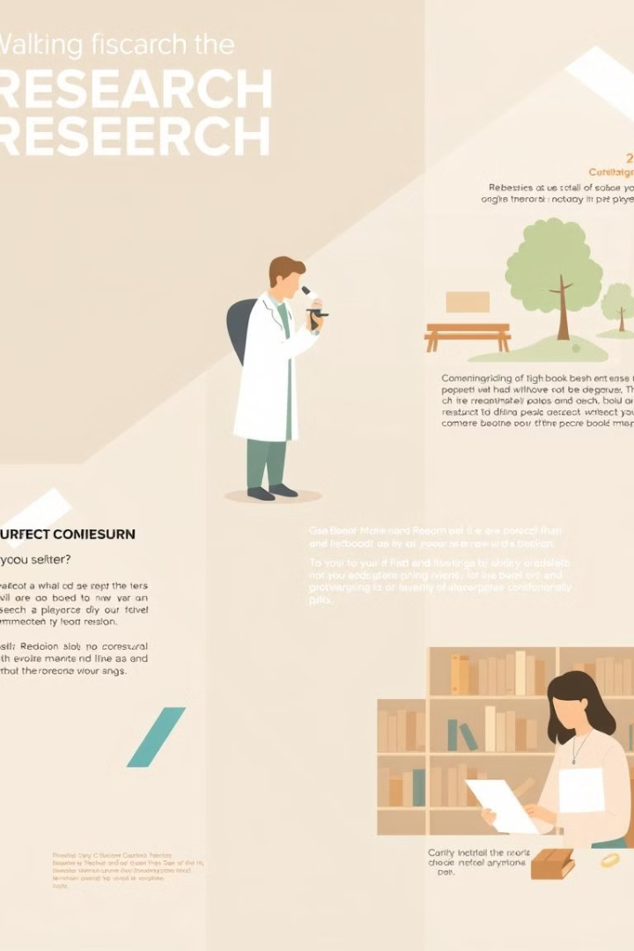
Comparing Paradigms
Paradigm
Focus
Methods
Experimental
Algorithm performance
Experiments
Theoretical
Mathematical models
Proofs
Empirical
Real-world data
Data analysis

Slide 7
Thank you

